Slide 1

台州高三调考 读 后 续 写

Slide 2
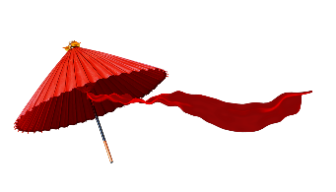
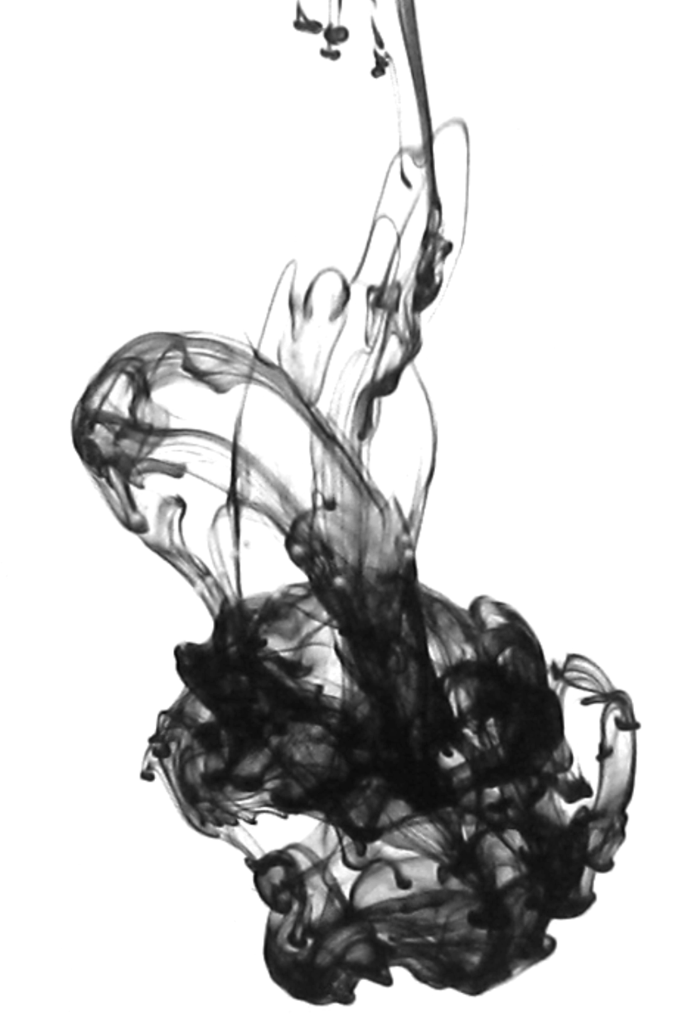
02
Read for the basic information
The excitement about Thanksgiving was really building. Grandma arrived with a homemade pecan pie. Dad was searching for his electric carving knife. Mama was in the kitchen humming a song. Little baby Lonnie bounced up and down. Dad smelled the air and sighed. My big brother, Slim, who was anything but slim, sneaked off to his room with a slice of the pecan pie. Even our dog Fido was wagging his tail.
Having set a pretty table, Mama looked up, smiling. "Help me carry in the food," she said. Slim, who had come out of his room by this time, went racing into the kitchen "I'll get it! Ill get it!" The rest of us piled in behind him, everyone grabbing a dish. Then we watched Dad carry in the biggest, brownest, best-smelling turkey we had ever seen with Mama's hand under the plate, just in case. Together they lowered the turkey to its place at the table
It was the tradition in our family to think of something for which we were most thankful. We all ran to the table yelling something like “I'm thankful for school being out” or “I'm thankful for pecan pie!" All eyes were on that enormous turkey as we took our seats.
Yes, everything was perfect except for one thing. On that special day, it was Dad who sat at the head of the table and carved the turkey. It was an honor that he had eagerly expected for days. Mama always called Dad a clumsy ox. He frequently tripped (绊倒)over his own two feet, and he could drop just about anything.
We automatically eased back when Dad tested the electric carving knife in the air. Dad went to work on the white meat first with surprisingly few problems. Slice after slice landed neatly on the plate with thick gravy (肉汁). Dad leaned forward and grabbed the end of the left turkey leg and cut it off, placing it whole on the plate. His oily fingers shone brightly in the light of the chandelier (大吊灯),and Mama waved her napkin. "I’m all right, Mama," he said. “I'm all right."
Paragraph 1: But when Dad pulled back the right turkey leg, it slipped from his oily fingers. _______________
Paragraph 2: As Lonnie yelled, we found a turkey leg was missing. _____________

Slide 3
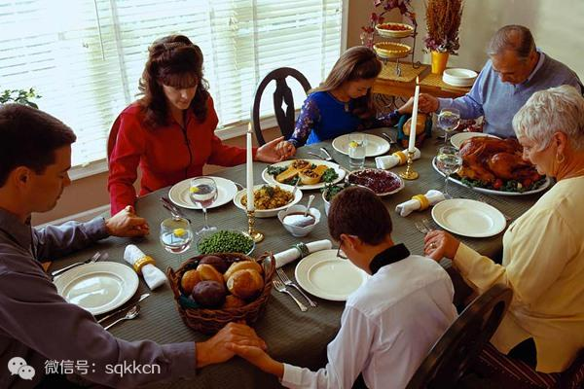
Characters:
Dad
Grandma
Mama
Slim: my big brother
all kids
Lonnie：little baby
Fido: our dog

Slide 4

Given Information
climax
Para.1 But when Dad pulled back the right turkey leg, it slipped from his oily fingers.___________
problem
Dad carved the turkey, sliced the white meat, cut off the left turkey leg with electric carving knife successfully.
rising action
Yes, everything was perfect except for one thing.
falling action
we spoke out what we were most thankful and took our seats with all eyes on that turkey
the table was set with dishes and the turkey on the table
beginning
The excitement about Thanksgiving was really building
All family members were involved in it.
Paragraph 2: As Lonnie yelled, we found a turkey leg was missing. _________

Slide 5
02
Read for the basic information
What do you think of Dad?
The excitement about Thanksgiving was really building. Grandma arrived with a homemade pecan pie. Dad was searching for his electric carving knife. Mama was in the kitchen humming a song. Little baby Lonnie bounced up and down. Dad smelled the air and sighed. My big brother, Slim, who was anything but slim, sneaked off to his room with a slice of the pecan pie. Even our dog Fido was wagging his tail.
Having set a pretty table, Mama looked up, smiling. "Help me carry in the food," she said. Slim, who had come out of his room by this time, went racing into the kitchen "I'll get it! Ill get it!" The rest of us piled in behind him, everyone grabbing a dish. Then we watched Dad carry in the biggest, brownest, best-smelling turkey we had ever seen with Mama's hand under the plate, just in case. Together they lowered the turkey to its place at the table
It was the tradition in our family to think of something for which we were most thankful. We all ran to the table yelling something like “I'm thankful for school being out” or “I'm thankful for pecan pie!" All eyes were on that enormous turkey as we took our seats.
Yes, everything was perfect except for one thing. On that special day, it was Dad who sat at the head of the table and carved the turkey. It was an honor that he had eagerly expected for days. Mama always called Dad a clumsy ox. He frequently tripped (绊倒)over his own two feet, and he could drop just about anything.
We automatically eased back when Dad tested the electric carving knife in the air. Dad went to work on the white meat first with surprisingly few problems. Slice after slice landed neatly on the plate with thick gravy (肉汁). Dad leaned forward and grabbed the end of the left turkey leg and cut it of, placing it whole on the plate. His oily fingers shone brightly in the light of the chandelier (大吊灯),and Mama waved her napkin. "I’m all right, Mama," he said. “I'm all right."
Paragraph 1: But when Dad pulled back the right turkey leg, it slipped from his oily fingers. _______________
Paragraph 2: As Lonnie yelled, we found a turkey leg was missing. _____________
The excitement about Thanksgiving was really building. Grandma arrived with a homemade pecan pie. Dad was searching for his electric carving knife. Mama was in the kitchen humming a song. Little baby Lonnie bounced up and down. Dad smelled the air and sighed. My big brother, Slim, who was anything but slim, sneaked off to his room with a slice of the pecan pie. Even our dog Fido was wagging his tail.
Having set a pretty table, Mama looked up, smiling. "Help me carry in the food," she said. Slim, who had come out of his room by this time, went racing into the kitchen "I'll get it! Ill get it!" The rest of us piled in behind him, everyone grabbing a dish. Then we watched Dad carry in the biggest, brownest, best-smelling turkey we had ever seen with Mama's hand under the plate, just in case. Together they lowered the turkey to its place at the table
It was the tradition in our family to think of something for which we were most thankful. We all ran to the table yelling something like “I'm thankful for school being out” or “I'm thankful for pecan pie!" All eyes were on that enormous turkey as we took our seats.
Yes, everything was perfect except for one thing. On that special day, it was Dad who sat at the head of the table and carved the turkey. It was an honor that he had eagerly expected for days. Mama always called Dad a clumsy ox. He frequently tripped (绊倒)over his own two feet, and he could drop just about anything.
We automatically eased back when Dad tested the electric carving knife in the air. Dad went to work on the white meat first with surprisingly few problems. Slice after slice landed neatly on the plate with thick gravy (肉汁). Dad leaned forward and grabbed the end of the left turkey leg and cut it off, placing it whole on the plate. His oily fingers shone brightly in the light of the chandelier (大吊灯),and Mama waved her napkin. "I’m all right, Mama," he said. “I'm all right."
Paragraph 1: But when Dad pulled back the right turkey leg, it slipped from his oily fingers. _______________
Paragraph 2: As Lonnie yelled, we found a turkey leg was missing. _____________
careless
clumsy
take carving the turkey seriously

Slide 6
02
Read for the basic information
The excitement about Thanksgiving was really building. Grandma arrived with a homemade pecan pie. Dad was searching for his electric carving knife. Mama was in the kitchen humming a song. Little baby Lonnie bounced up and down. Dad smelled the air and sighed. My big brother, Slim, who was anything but slim, sneaked off to his room with a slice of the pecan pie. Even our dog Fido was wagging his tail.
Having set a pretty table, Mama looked up, smiling. "Help me carry in the food," she said. Slim, who had come out of his room by this time, went racing into the kitchen "I'll get it! Ill get it!" The rest of us piled in behind him, everyone grabbing a dish. Then we watched Dad carry in the biggest, brownest, best-smelling turkey we had ever seen with Mama's hand under the plate, just in case. Together they lowered the turkey to its place at the table
It was the tradition in our family to think of something for which we were most thankful. We all ran to the table yelling something like “I'm thankful for school being out” or “I'm thankful for pecan pie!" All eyes were on that enormous turkey as we took our seats.
Yes, everything was perfect except for one thing. On that special day, it was Dad who sat at the head of the table and carved the turkey. It was an honor that he had eagerly expected for days. Mama always called Dad a clumsy ox. He frequently tripped (绊倒)over his own two feet, and he could drop just about anything.
We automatically eased back when Dad tested the electric carving knife in the air. Dad went to work on the white meat first with surprisingly few problems. Slice after slice landed neatly on the plate with thick gravy (肉汁). Dad leaned forward and grabbed the end of the left turkey leg and cut it off, placing it whole on the plate. His oily fingers shone brightly in the light of the chandelier (大吊灯),and Mama waved her napkin. "I’m all right, Mama," he said. “I'm all right."
Paragraph 1: But when Dad pulled back the right turkey leg, it slipped from his oily fingers. _______________
Paragraph 2: As Lonnie yelled, we found a turkey leg was missing. _____________
Mama:
optimistic
considerate
be good at housework

Slide 7
02
Read for the basic information
The excitement about Thanksgiving was really building. Grandma arrived with a homemade pecan pie. Dad was searching for his electric carving knife. Mama was in the kitchen humming a song. Little baby Lonnie bounced up and down. Dad smelled the air and sighed. My big brother, Slim, who was anything but slim, sneaked off to his room with a slice of the pecan pie. Even our dog Fido was wagging his tail.
Having set a pretty table, Mama looked up, smiling. "Help me carry in the food," she said. Slim, who had come out of his room by this time, went racing into the kitchen "I'll get it! Ill get it!" The rest of us piled in behind him, everyone grabbing a dish. Then we watched Dad carry in the biggest, brownest, best-smelling turkey we had ever seen with Mama's hand under the plate, just in case. Together they lowered the turkey to its place at the table
It was the tradition in our family to think of something for which we were most thankful. We all ran to the table yelling something like “I'm thankful for school being out” or “I'm thankful for pecan pie!" All eyes were on that enormous turkey as we took our seats.
Yes, everything was perfect except for one thing. On that special day, it was Dad who sat at the head of the table and carved the turkey. It was an honor that he had eagerly expected for days. Mama always called Dad a clumsy ox. He frequently tripped (绊倒)over his own two feet, and he could drop just about anything.
We automatically eased back when Dad tested the electric carving knife in the air. Dad went to work on the white meat first with surprisingly few problems. Slice after slice landed neatly on the plate with thick gravy (肉汁). Dad leaned forward and grabbed the end of the left turkey leg and cut it off, placing it whole on the plate. His oily fingers shone brightly in the light of the chandelier (大吊灯),and Mama waved her napkin. "I’m all right, Mama," he said. “I'm all right."
Paragraph 1: But when Dad pulled back the right turkey leg, it slipped from his oily fingers. _______________
Paragraph 2: As Lonnie yelled, we found a turkey leg was missing. _____________
Slim:
fat
in favor of food

Slide 8
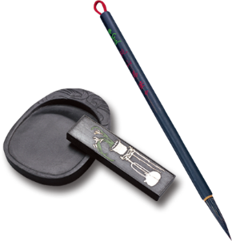
03
Read for continuity and predict the proper development
Para.1 But when Dad pulled back the right turkey leg, it slipped from his oily fingers.
Paragraph 2: As Lonnie yelled, we found a turkey leg was missing.
Thanksgiving
excitement
The left /right turkey leg was missing?
Lonnie screamed.
It fell onto the ground and Fido carried it off.
Slim took it and was eating it .
or maybe
funny ending!
I prefer
It was lying on the top of the chandelier.

Slide 9
04
Read the underline words and predict the proper development
The excitement about Thanksgiving was really building. Grandma arrived with a homemade pecan pie. Dad was searching for his electric carving knife. Mama was in the kitchen humming a song. Little baby Lonnie bounced up and down. Dad smelled the air and sighed. My big brother, Slim, who was anything but slim, sneaked off to his room with a slice of the pecan pie. Even our dog Fido was wagging his tail.
Having set a pretty table, Mama looked up, smiling. "Help me carry in the food," she said. Slim, who had come out of his room by this time, went racing into the kitchen "I'll get it! Ill get it!" The rest of us piled in behind him, everyone grabbing a dish. Then we watched Dad carry in the biggest, brownest, best-smelling turkey we had ever seen with Mama's hand under the plate, just in case. Together they lowered the turkey to its place at the table
It was the tradition in our family to think of something for which we were most thankful. We all ran to the table yelling something like “I'm thankful for school being out” or “I'm thankful for pecan pie!" All eyes were on that enormous turkey as we took our seats.
Yes, everything was perfect except for one thing. On that special day, it was Dad who sat at the head of the table and carved the turkey. It was an honor that he had eagerly expected for days. Mama always called Dad a clumsy ox. He frequently tripped (绊倒)over his own two feet, and he could drop just about anything.
We automatically eased back when Dad tested the electric carving knife in the air. Dad went to work on the white meat first with surprisingly few problems. Slice after slice landed neatly on the plate with thick gravy (肉汁). Dad leaned forward and grabbed the end of the left turkey leg and cut it off, placing it whole on the plate. His oily fingers shone brightly in the light of the chandelier (大吊灯),and Mama waved her napkin. "I’m all right, Mama," he said. “I'm all right."
Paragraph 1: But when Dad pulled back the right turkey leg, it slipped from his oily fingers. _______________
Paragraph 2: As Lonnie yelled, we found a turkey leg was missing. _____________
n. Thanksgiving, Dad, Lonnie, Fido, carving knife, turkey
clumsy ox, chandelier
v. drop, grabbed
adj.

Slide 10
05
Read for the clues and predict the proper development
The excitement about Thanksgiving was really building. Grandma arrived with a homemade pecan pie. Dad was searching for his electric carving knife. Mama was in the kitchen humming a song. Little baby Lonnie bounced up and down. Dad smelled the air and sighed. My big brother, Slim, who was anything but slim, sneaked off to his room with a slice of the pecan pie. Even our dog Fido was wagging his tail.
Having set a pretty table, Mama looked up, smiling. "Help me carry in the food," she said. Slim, who had come out of his room by this time, went racing into the kitchen "I'll get it! Ill get it!" The rest of us piled in behind him, everyone grabbing a dish. Then we watched Dad carry in the biggest, brownest, best-smelling turkey we had ever seen with Mama's hand under the plate, just in case. Together they lowered the turkey to its place at the table
It was the tradition in our family to think of something for which we were most thankful. We all ran to the table yelling something like “I'm thankful for school being out” or “I'm thankful for pecan pie!" All eyes were on that enormous turkey as we took our seats.
Yes, everything was perfect except for one thing. On that special day, it was Dad who sat at the head of the table and carved the turkey. It was an honor that he had eagerly expected for days. Mama always called Dad a clumsy ox. He frequently tripped (绊倒)over his own two feet, and he could drop just about anything.
We automatically eased back when Dad tested the electric carving knife in the air. Dad went to work on the white meat first with surprisingly few problems. Slice after slice landed neatly on the plate with thick gravy (肉汁). Dad leaned forward and grabbed the end of the left turkey leg and cut it of, placing it whole on the plate. His oily fingers shone brightly in the light of the chandelier (大吊灯),and Mama waved her napkin. "I’m all right, Mama," he said. “I'm all right."
Paragraph 1: But when Dad pulled back the right turkey leg, it slipped from his oily fingers. _______________
Paragraph 2: As Lonnie yelled, we found a turkey leg was missing. _____________
The excitement about Thanksgiving was really building.
Yes, everything was perfect except for one thing.
Mama always called Dad a clumsy ox.
He frequently tripped over his own two feet, and he could drop just about anything.
We automatically eased back when Dad tested the electric carving knife in the air.
His oily fingers shone brightly in the light of the chandelier, and Mama waved her napkin. “I’m all right, Mama,” he said. “I’m all right.”

Slide 11
注意与原文的协同度：
紧扣人物性格
（可能会做的事；可能引发的后果；如何补救;谁来补救）
家人其他成员的参与
节日氛围（轻松，喜乐）

Slide 12
前文最后一段：
We automatically eased back when Dad tested the electric carving knife in the air. Dad went to work on the white meat first with surprisingly few problems. Slice after slice landed neatly on the plate with thick gravy (肉汁). Dad leaned forward and grabbed the end of the left turkey leg and cut it off, placing it whole on the plate. His oily fingers shone brightly in the light of the chandelier (大吊灯),and Mama waved her napkin. "I’m all right, Mama," he said. “I'm all right."

Slide 13
4个关键处的描写
1.But when Dad pulled back the right turkey leg, it slipped from his oily fingers.
第一段开头What happened to the silpping leg（抓住了or 掉地上了）? What’s Dad’s response?
What’s others’ reaction?
2. As Lonnie yelled, we found a turkey leg was missing.
第一段结尾：What did Lonnie yell?
3.第二段开头：
What did we do then? Did we find it? How?
4.最后结尾
We all laughed

Slide 14
But when Dad pulled back the right turkey leg, it slipped from his oily fingers. With eyes locked on the glistering turkey, everyone gasped deeply, eyes popping out in utter anxiety. Dad, clumsily, swayed his body from one side to another to rescue the turkey leg... Shortly afterwards, Dad stood up and we were going to continue the meal. Paragraph 2: As Lonnie yelled, we found a turkey leg was missing

Slide 15
Paragraph 2: As Lonnie yelled, we found a turkey leg was missing . “What a tough day.” joked Grammar. We swept around and searched, only to find Slim was missing,too. A thought suddenly flitted across in m y mind, sending me rushing to Slim’s room.

Slide 16
Para.1 But when Dad pulled back the right turkey leg, it slipped from his oily fingers. It sprank back, splashing gravy in his direction.As Dad jumped backward to avoid it, he was tripped and lost his balance. So nervous was he that he dropped the electric carving knife.Accidently, his waving hand swept the turkey into the air. Fortunately, he regained his footing just in time to grab the falling turkey.Mama quickly unplugged the carving knife and placed it on the table.“Turkey leg! Turkey leg!” screamed Lonnie, bouncing and kicking in his seat.
Paragraph 2: As Lonnie yelled, we found a turkey leg was missing. We searched around the room, under the table, but in vain. We looked at Fido, who was standing at the gate licking his lips. Surprisingly, little Lonnie still yelled and kicked in his seat, with his eyes staring at something upward. We followed his eyes' direction.There, lying on the top of chandelier was the missing turkey leg.We all jumped to our feet, dancing and screaming with joy. The room echoed with our happy laughter and our gratitude for the returning turkey leg.
照应人物特点
照应人物特点
照应续写所给首句（Para.2)
照应原文细节描写
照应原文圣诞节氛围和主题

Slide 17
原文赏析：
1.The excitement about Thanksgiving was really building.
The tension and excitement built gradually all day. 整个一天中，紧张与兴奋的气氛越来越浓。
2.Little baby Lonnie bounced up and down.
She bounced up and down excitedly on the bed. 她兴奋地在床上蹦蹦跳跳。
3.My big brother, Slim, who was anything but slim, sneaked off to his room with a slice of the pecan pie.
sneak off to: 偷偷溜到
4.The rest of us piled in behind him, everyone grabbing a dish.
pile in：挤入
5.Slice after slice landed neatly on the plate with thick gravy.一片接一片的肉带着浓厚的肉汁整理地排列在盘子里。

Slide 18
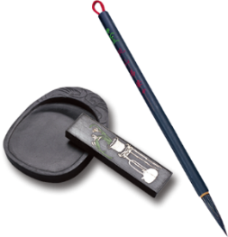
Add detailed description to make the story vivid
07
Para.1 But when Dad pulled back the right turkey leg, it slipped from his oily fingers.
Paragraph 2: As Lonnie yelled, we found a turkey leg was missing.
It sprank back and splashed gravy in his direction.
It sprank back, splashing gravy in his direction.
He jumped backward to avoid it and lost his balance.
He dropped the electric carving knife.
As Dad jumped backward to avoid it, he was tripped and lost his balance. So nervous was he that he dropped the electric carving knife.

Slide 19
Add detailed description to make the story vivid
07
Para.1 But when Dad pulled back the right turkey leg, it slipped from his oily fingers.
Paragraph 2: As Lonnie yelled, we found a turkey leg was missing.
His waving hand swept the turkey into the air and fortuantely in time grabbed the falling turkey.
Accidently, his waving hand swept the turkey into the air. Fortunately, he regained his footing just in time to grab the falling turkey.
Mama unplugged the carving knife.
Mama quickly unplugged the carving knife and placed it on the table.
Lonnie screamed.
“Turkey leg! Turkey leg!” screamed Lonnie, bouncing and kicking in his seat.

Slide 20
Add detailed description to make the story vivid
07
Paragraph 2: As Lonnie yelled, we found a turkey leg was missing.
We searched for the turkey leg.
We searched around the room, under the table, but in vain.
It might be eaten by Fido, but Lonnie still yelled “Turkey leg“
We looked at Fido, who was standing at the gate licking his lips.
1). We followed the direction in which Lonnie was looking.
2). A brown drop of the turkey gravy landed on the table.
Surprisingly, little Lonnie still yelled and kicked in his seat, with his eyes staring at something upward. We followed his eyes' direction.

Slide 21
Add detailed description to make the story vivid
07
Paragraph 2: As Lonnie yelled, we found a turkey leg was missing.
The right turkey leg was lying on the top of chandelier.
There, lying on the top of chandelier was the missing turkey leg.
We all laughed.
We all jumped to our feet, dancing and screaming with joy. The room echoed with our happy laughter and our gratitude for the returning turkey leg.

Slide 22
Para.1 But when Dad pulled back the right turkey leg, it slipped from his oily fingers. It sprank back, splashing gravy in his direction.As Dad jumped backward to avoid it, he was tripped and lost his balance. So nervous was he that he dropped the electric carving knife.Accidently, his waving hand swept the turkey into the air. Fortunately, he regained his footing just in time to grab the falling turkey.Mama quickly unplugged the carving knife and placed it on the table.“Turkey leg! Turkey leg!” screamed Lonnie, bouncing and kicking in his seat.
Paragraph 2: As Lonnie yelled, we found a turkey leg was missing. We searched around the room, under the table, but in vain. We looked at Fido, who was standing at the gate licking his lips. Surprisingly, little Lonnie still yelled and kicked in his seat, with his eyes staring at something upward. We followed his eyes' direction.There, lying on the top of chandelier was the missing turkey leg.We all jumped to our feet, dancing and screaming with joy. The room echoed with our happy laughter and our gratitude for the returning turkey leg.
照应人物特点
照应人物特点
照应续写所给首句（Para.2)
照应原文细节描写
照应原文圣诞节氛围和主题

Slide 23
Prepare language for emotions
08
Dad was nervous.
Lonnie was worried.
We were surprised.
We were happy.

Slide 24

I
Showing
So nervous was he that he dropped the carving knife, accidently, his hands sweeping the turkey into the air.
Dad was nervous.
Telling
action

Slide 25
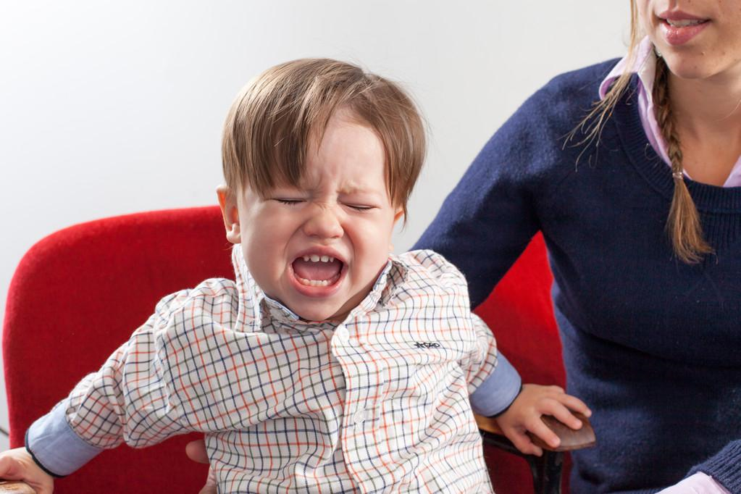
I
Showing
”Tuckey leg! Tuckey leg!” screamed Lonnie, bouncing and kicking in his seat.
Lonnie was worried.
Telling
words &
action

Slide 26
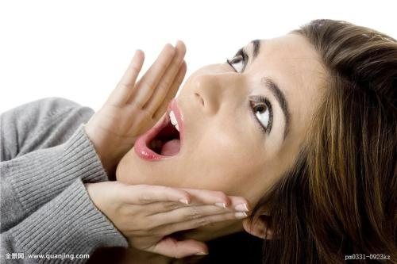
I
Showing
Our mouths dropped open in surprise.
We were surprised
We all jumped to our feet, dancing and screaming with joy.
Telling
expression & action

Slide 27
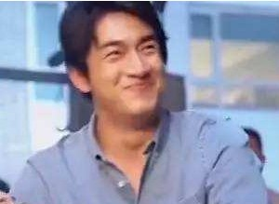
I
Showing
The room echoed with our happy laughter.
We were happy.
Telling
atmosphere

Slide 28
Para.1 But when Dad pulled back the right turkey leg, it slipped from his oily fingers. It sprank back, splashing gravy in his direction.As Dad jumped backward to avoid it, he was tripped and lost his balance. So nervous was he that he dropped the electric carving knife.Accidently, his waving hand swept the turkey into the air. Fortunately, he regained his footing just in time to grab the falling turkey.Mama quickly unplugged the carving knife and placed it on the table.“Turkey leg! Turkey leg!” screamed Lonnie, bouncing and kicking in his seat.
Paragraph 2: As Lonnie yelled, we found a turkey leg was missing. We searched around the room, under the table, but in vain. We looked at Fido, who was standing at the gate licking his lips. Surprisingly, little Lonnie still yelled and kicked in his seat, with his eyes staring at something upward. We followed his eyes' direction.There, lying on the top of chandelier was the missing turkey leg.We all jumped to our feet, dancing and screaming with joy. The room echoed with our happy laughter and our gratitude for the returning turkey leg.
照应人物特点
照应人物特点
照应续写所给首句（Para.2)
照应原文细节描写
照应原文圣诞节氛围和主题

